Slide 1
Demonstrate Attacks and Countermeasure in Mobile Computing
Mohd Alif Erfan, Security Evaluation Analyst
Malaysian Security Evaluation Facility (MySEF)
CyberSecurity Malaysia (CSM)
m.aliferfan@cybersecurity.my

Slide 2
Agenda
Introduction
Android mobile architecture
Threats and vulnerabilities
Countermeasures
Demo

Slide 3
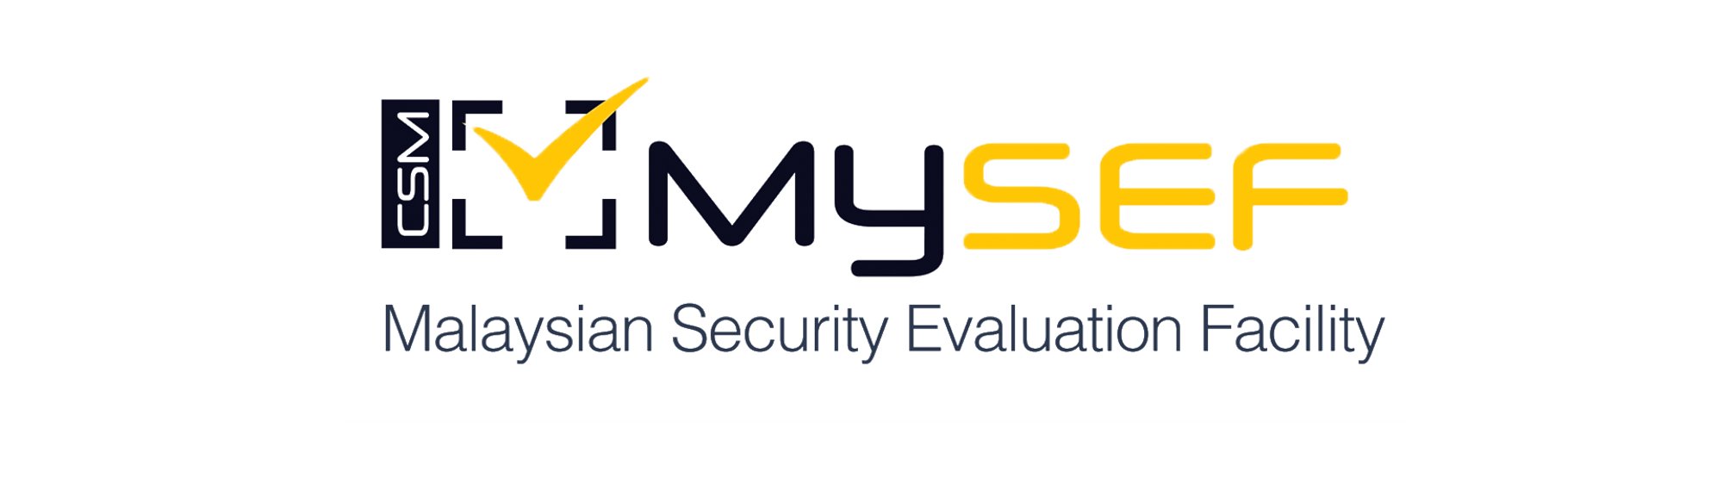
Introduction
Malaysian Security Evaluation Facility (MySEF)

Slide 4
MySEF
Services and expertise
Evaluation and Assessment Service
Laboratory Services
Evaluation and Assessment Service is an independent evaluation facility by CSM MySEF to evaluate the ICT products and systems under various certifications schemes or initiatives, namely Common Criteria Evaluation & Certification (MyCC), Technology Security Assurance (TSA) and ICT Product Security Assessment (IPSA).
Laboratory Services is offered to external laboratories for laboratory/equipment rental and Inter-Laboratory Comparison (ILC) exercise.
ISO 17025 Professional Laboratory Service and Equipment rental for ICT products testing and evaluation services
Inter-Laboratory Comparison (ILC) exercise is mandatory for any ISO/IEC 17025 Test Lab in Malaysia. CSM MySEF offers this service based on the Scope of Work (SOW) agreed by both Test Labs which covers security evaluations, security functional testing or penetration testing
Cloud Security Services
Cloud Security Services is a niche security service on cloud computing, focusing on cloud computing implementation on all types of cloud services model (IaaS,PaaS and SaaS). This service is provided to Cloud Service Providers, Cloud Service Subscribers and Cloud Service Brokers which allow organizations to ensure secured cloud deployment and service subscription.
Common Criteria, Cloud Security and Smart Card Security Training Services
Advisory Services
Advisory Services provides technical services and advisories to existing and potential CC laboratories, in terms of developing Standard Operating Procedure (SOP) and preparing for accreditation
Extensive training on niche subjects, we also provide specialized trainings that cater various of vast technologies.

Slide 5
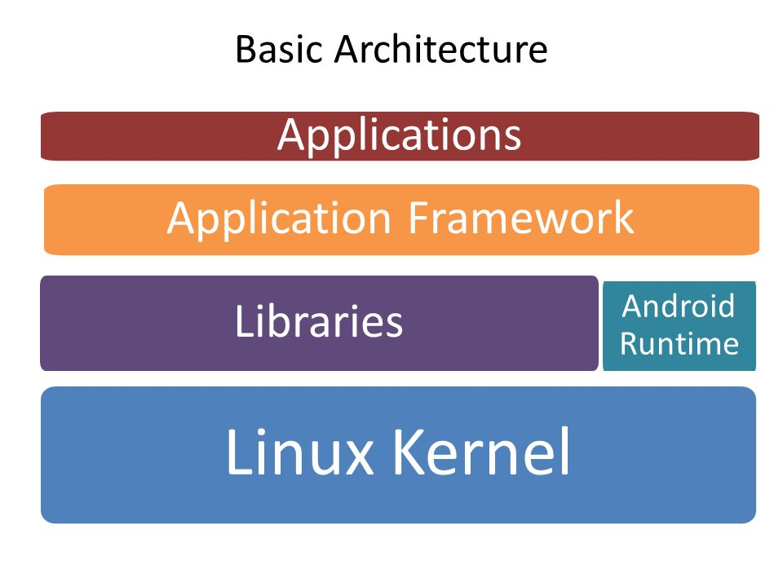

Android
architecture
Android is one of the most popular OS used in Mobile Phones specifically Smart Phones. It runs on top of Linux OS and its available for free and open source. Android architecture cover various layers associated with Android Software starting from Linux kernel to Applications.
Basic Architetcure
Detailed Architecture
Linux Kernel
Libraries
Android Runtime
Application Framework
Applications
Display Driver
Surface manager, SQLite
Core Libraries
Activity manager
Home, Browser

Slide 6





Android
architecture
Secure inter-process communication
In Android, it has built in security features that incorporates security for its users as well as developers.
Android application processes can communicate with each other in other several ways.
Security at the OS level through the Linux Kernel
Application signing
Unlike regular Linux, Android application runs a separate process with a unique user ID.
Application signing ensures every application signed by the developer.
Application defined-user granted permissions
Application sandboxing
Application specifically need to request for the permissions for accessing any resources.
Each Android application run in its own sandboxed environment.

Slide 7
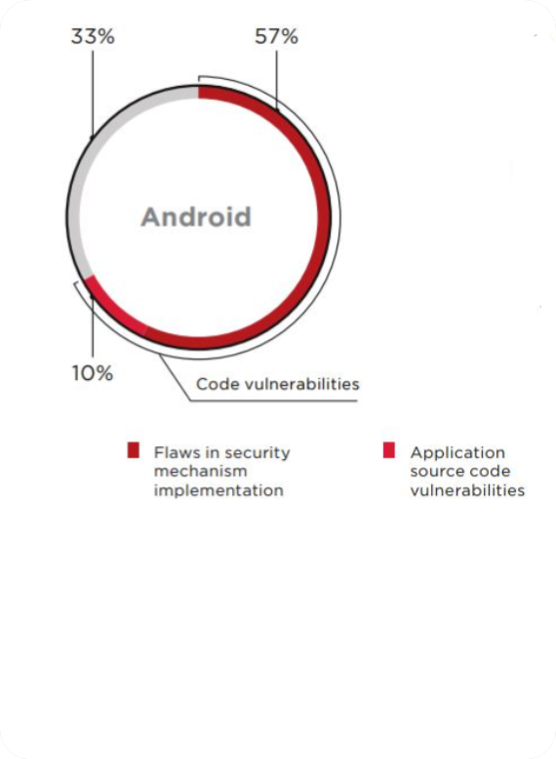
Threats
and Vulnerabilities
Any technologies and computing are not escaped from threats and vulnerabilities. For mobile applications, insecure data storage is the most common issue, found in most of mobile applications. Passwords, financial information, personal data, and correspondence are at risk.
Study shows that up to 57% for flaws in security mechanism implementation, 10% for application source code vulnerabilities. Other 33% vulnerabilities are mostly by misconfiguration.
Studied made by Positive Technology Security

Slide 8
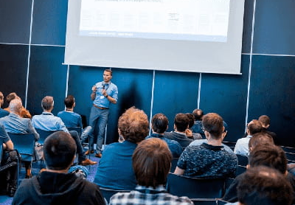
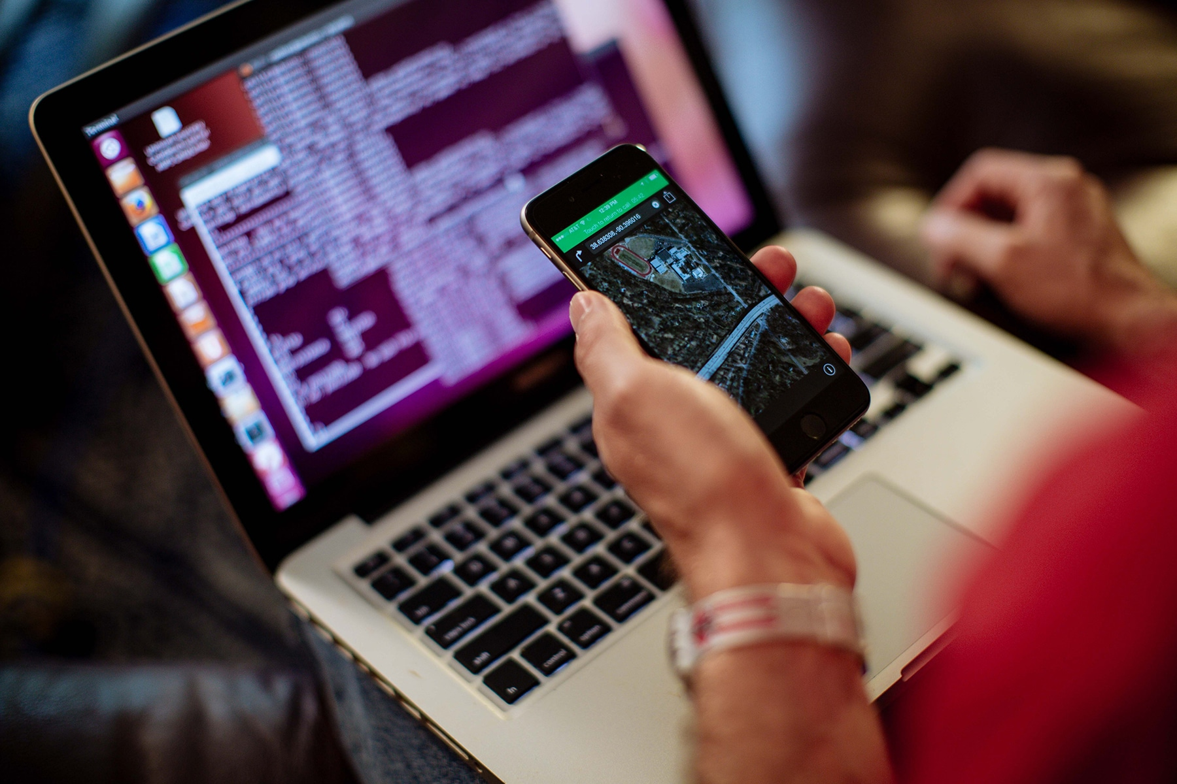
Threats
and Vulnerabilities
In common practices, Android applications are commonly exposed to several risks and experts has identified into 10 categories of risks.
OWASP Mobile Top 10 Risks 2017 consist of:
M1: Improper Platform Usage
M2: Insecure Data Storage
M3: Insecure Communication
M4: Insecure Authentication
M5: Insufficient Cryptography
M6: Insecure Authorization
M7: Client Code Quality
M8: Code Tampering
M9: Reverse Engineering
M10: Extraneous Functionality

Slide 9

Threats
and Vulnerabilities
In adversary perspectives, understanding the nature of mobile devices are most crucial things as every applications are not perfect and no application are unhackable.
Exploitation often occurred because of the lack of awareness about the mobile security and safety from individual despite the malware itself.

Slide 10
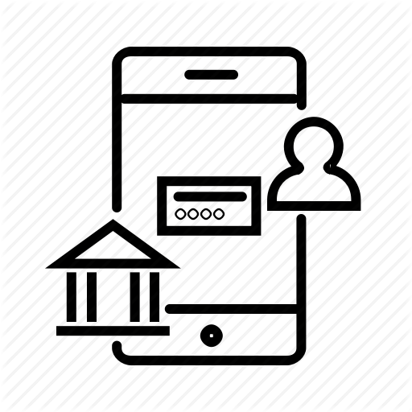

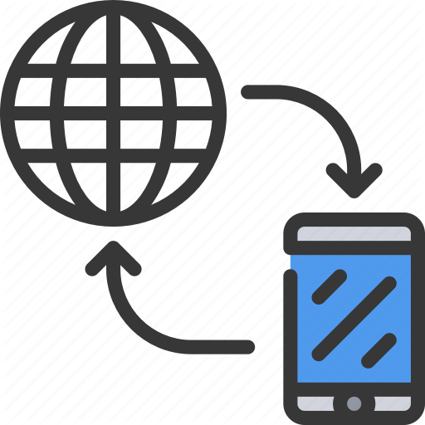
Threats
and Vulnerabilities
Assets that potentially seek by the attackers from mobile application are the user data itself.
Banking information
Data is the new gold! Precious data is the bank data. Depends on the nature of the banking application.
Social media contents
Contents from the social media application stored like sessions, graphics, and other info. Also included credentials like username and password.
Devices access
In a handful of cases exploiting vulnerabilities can be accomplished remotely via the Internet. But, physical access to the device also need to be put in attention too.

Slide 11
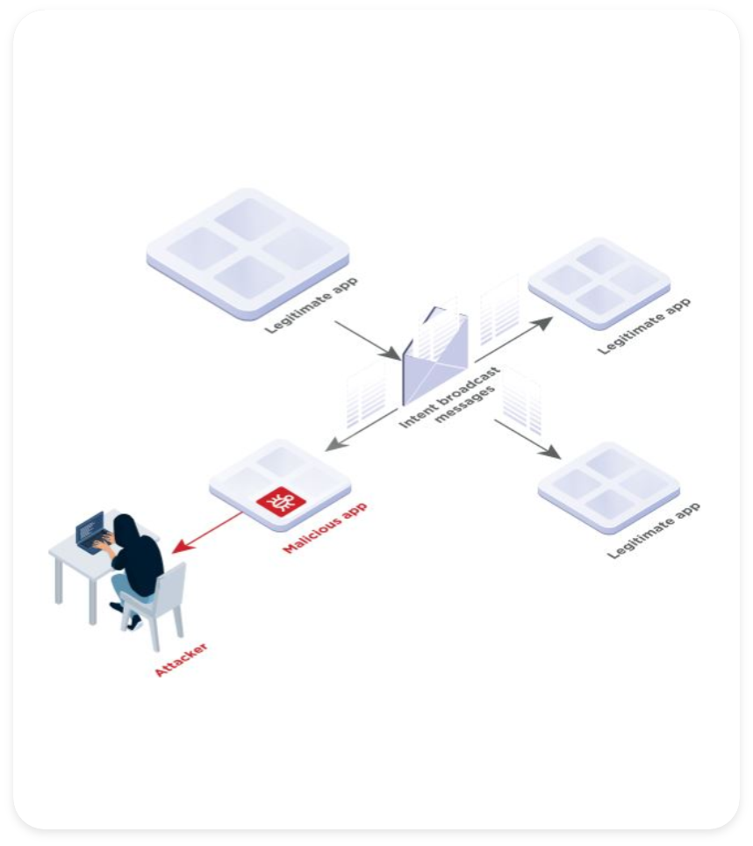
Threats
and Vulnerabilities
Things to consider:-
Motivation
Application type
Application workflow
Assets
Type of payload

Slide 12

Countermeasures
Hackers love targeting mobile devices, which are rich with personal data and payment card information. In resulting indicate that developers of mobile applications often neglect security, with the main issue being insecure data storage. User information stored in cleartext, unmasked data in screenshots, and keys and passwords in source code are just a few of the flaws that offer opportunities to cyber attackers.
Thus, preventive measure must be implemented from both parties developers and users.

Slide 13
Countermeasures
Some guideline and recommendations on user side to practice secure usage of mobile devices.
Install Apps only from trusted sources
Android application can be downloaded straight from the Google Play store, while for other OS may download from their own secure application store.
Never store sensitive information
Update Google Android antivirus or install antivirus
Don’t store sensitive information like passwords or pin in any visibly platform or application like SMS and Messenger apps.
Install an antivirus to avoid any unintended process or malicious activities running in the background.
Never root your device
Update the OS regularly
Rooting your mobile devices are welcoming any type of malware and threats. Its oppose more harm than advantages.
Always keep up to date with latest update of the OS version published by the developer. It usually will automatically downloaded and ask permission of user upon installation.
Don’t directly download Android Package (APK) files
Implement devices security
Typically harmful malware in form of APK outside the official store, make sure it’s a legitimate apps first.
Set up lock screen and other security features like face lock and password.

Slide 14

Demo!
Remote Attacks.

